Slide 1
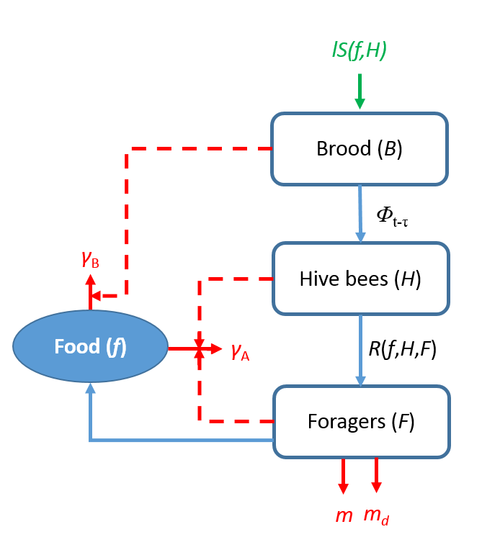
Experimental bioassay
Environmental pesticides investigation
Seasonality of Parameter Rate Ratios
Bee colony population dynamics
Imidacloprid exposure dose and mortality rate
Imidacloprid-induced mortality risk in short (10 day) and mid (30 day) term
Study Data
Imidacloprid-induced population extinction risk in long term period
Theoretical Model
Estimated Risk

Slide 2
food consumption by brood, hive bees, and foragers γ_{A}, γ_{B}
food collection by foragers
Food (f)
hive bees and food affecting brood survival
laying, l
social
inhibition, σ
Brood (B)
eclosion, ϕ
Hive bees (H)
Foragers (F)
transition to foraging, α
pesticide, m_{d}
death, m
increasing of foragers mortality by pesticide

Slide 3
lS(f,H)
Brood (B)
Φ_{t-τ}
γ_{B}
Hive bees (H)
Food (f)
γ_{A}
R(f,H,F)
Foragers (F)
m_{d}
m

Slide 4
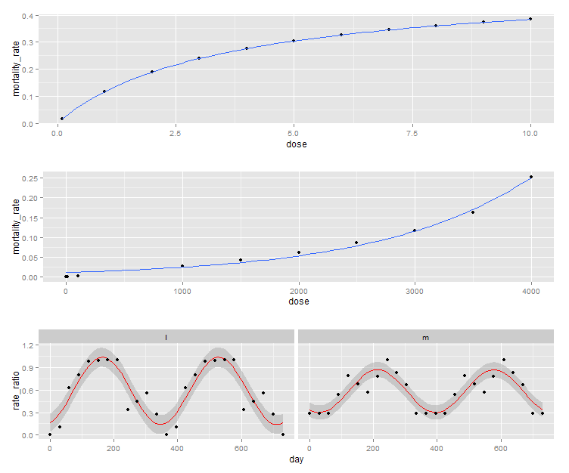

Slide 5
